Slide 1
Google Fusion Tables: Basics
Michael Howser
Undergraduate Education & GIS Librarian and Connecticut State Data Center Coordinator

Slide 2
What is Google Fusion Tables?
Web based interface for uploading, managing, and visualizing large datasets
Builds upon Google Docs and Google Maps
Includes API to develop custom interfaces
Enables sharing of large datasets

Slide 3
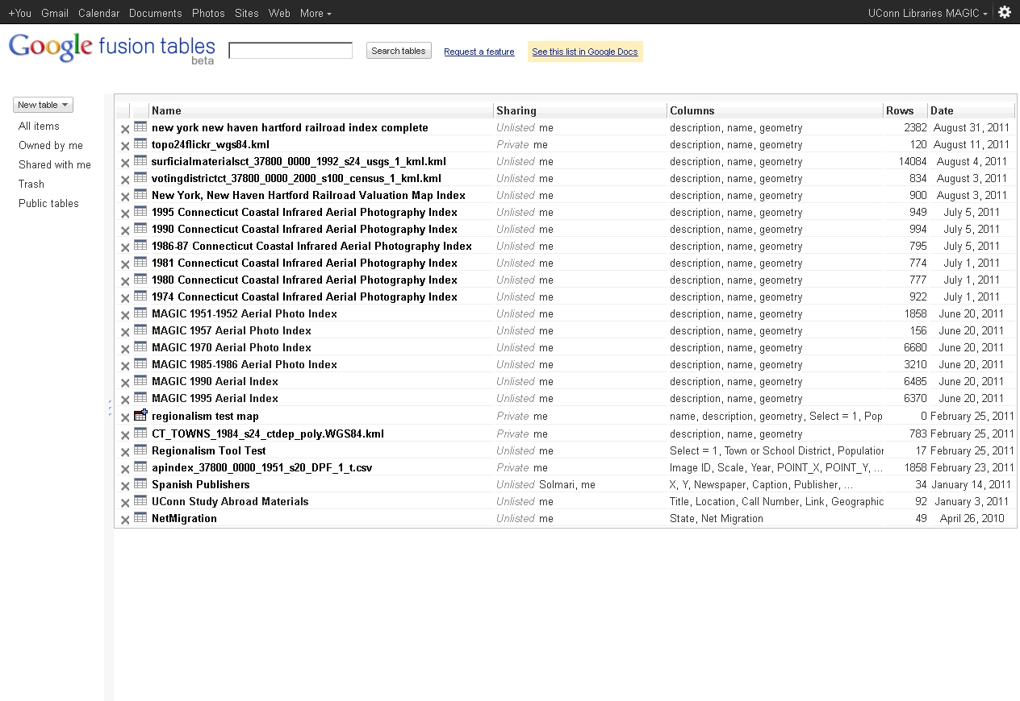
Accessing Google Fusion Tables
http://www.google.com/fusiontables

Slide 4
Importing Data
Data formats supported include:
  Spreadsheets (.csv, .tsv, or .txt)
  Google Docs Spreadsheets
  KML Files

Slide 5
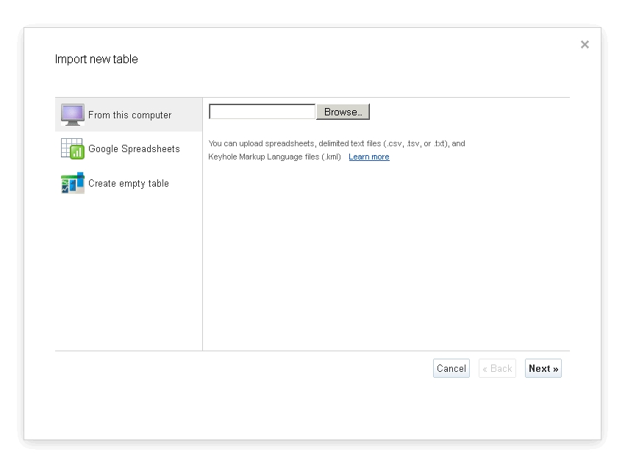
Importing Data

Slide 6
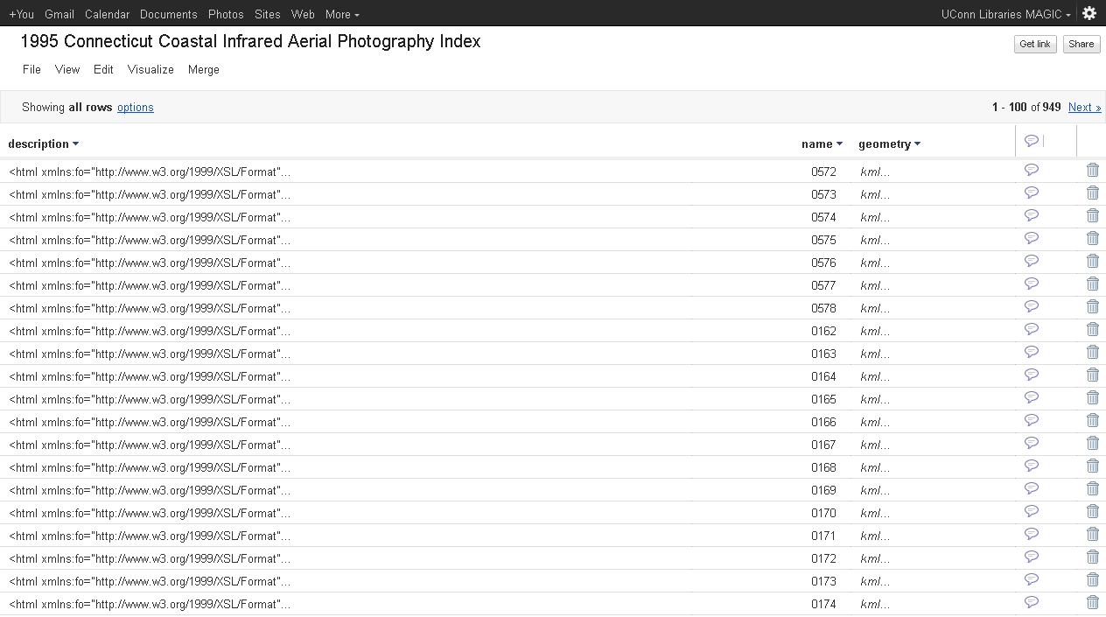
Sample Data Interface

Slide 7
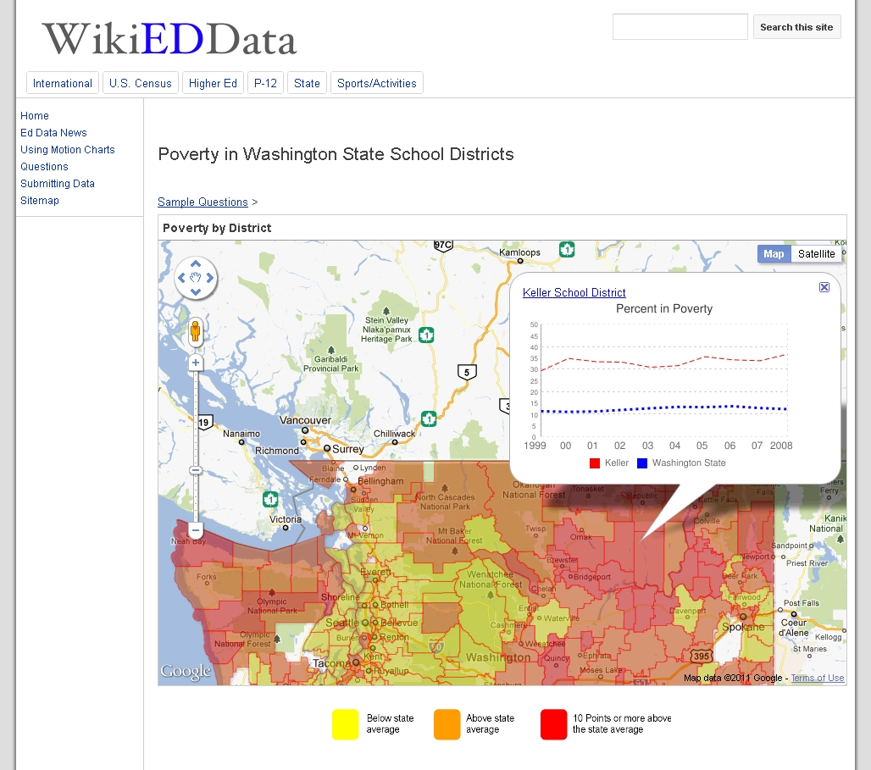
Let’s Explore!

Slide 8

Questions?
Map and Geographic Information Center – MAGIC & Connecticut State Data Center
at the University of Connecticut Libraries
369 Fairfield Way
Phone: 860-486-4589
E-mail: magic@uconn.edu or ctsdc@uconn.edu

